Slide 1

Indian Institute of information Technology Allahabad
Prayagraj (UP) India
Demonstration of Federated Learning using multiple systems
Group Members:
Rohan Singhvi (IIB2020004)
Akash Biswas (IIT2020001)
Shubham Bhokta (IIT2020007)
Aashish Agarwal (IIT2020009)
Rahul Mahto (IIT2020022)
Supervised By : Prof. K.P. Singh
Teaching Assistant : Inderjeet Sinha &
Avadhoot Daulat Bangal

Slide 2


Table of Contents
01
FL
02
Goals
03
Methods
04
05
Future Scope
06
Reference
Challenges

Slide 3
Problem Statement
Demonstration of Federated Learning using Multiple system and ANN model.

Slide 4
Introduction
Federated learning is a technique that allows multiple devices to train a shared model without sharing their raw data.
The technique was introduced in 2016 by Google and has since gained attention as a privacy-preserving approach to machine learning.
Federated learning enables the training of models on decentralized data while preserving privacy, reducing the need for data transfer and storage, and improving scalability.

Slide 5
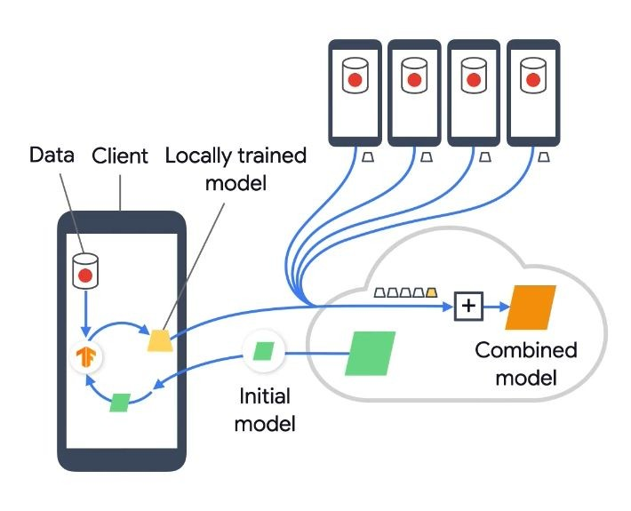
Federated Learning
FL is a Machine Learning Technique:
That trains an algorithm across multiple devices holding local data samples, without exchanging them.
Enables multiple actors to build a common, robust machine learning model without sharing data.
Application : Defence, telecommunication, Pharmaceutics, etc.
Figure 1 [1]

Slide 6
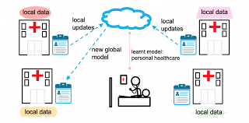
Federated Learning
Figure : 2 [4]

Slide 7
Challenges in Federated Learning
Managing heterogeneous systems in the same networks.
Communication and Synchronization.
Privacy concerns and Security risks.
Systems heterogeneity causes different completion times and fast clients have to wait for the slow clients, known as stragglers before model aggregation.

Slide 8
ANN
Artificial Neural Networks (ANNs) are a type of machine learning algorithm that are inspired by the structure and function of the human brain.
ANNs consist of interconnected nodes, called artificial neurons, that process and transmit information. The input data is fed into the input layer of the network, and then it passes through multiple hidden layers of neurons, which perform mathematical operations on the input data.

Slide 9
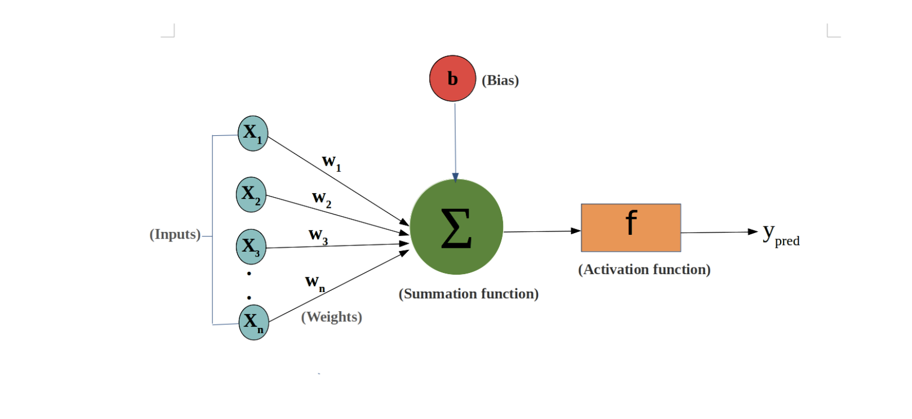
ANN

Slide 10
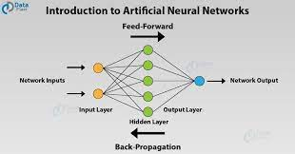
Architecture of Neural Network

Slide 11
Methodology
Data Preparation: The first step is to download the MNIST dataset and split it into non-overlapping subsets for each client​.
Model Architecture: The implementation uses a simple two-layer neural network model with 784 input units, 128 hidden units, and 10 output units​.
Client and Server Implementation: The repository includes the implementation of both client and server sides​

Slide 12
Methodology
Training Process: The training process involves multiple rounds of training on the local datasets followed by aggregation of the model updates at the server​
Model Evaluation: The implementation includes functionality to test the performance of the global model on a separate test dataset, allowing for evaluation of the model's accuracy over time

Slide 13
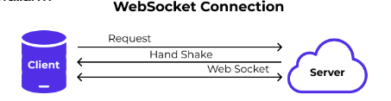
Implementation
It's a Server-Client based application written in Python to demonstrate the federated learning on MNIST dataset classification. The server and the clients communicate using web - socket method.
Client Implementation:
Makes a request from the server to get the updated model weights.
After the client has got the updated weights, it trains on the data and updates the model weights.
It tries to send the updated weights to the server.

Slide 14
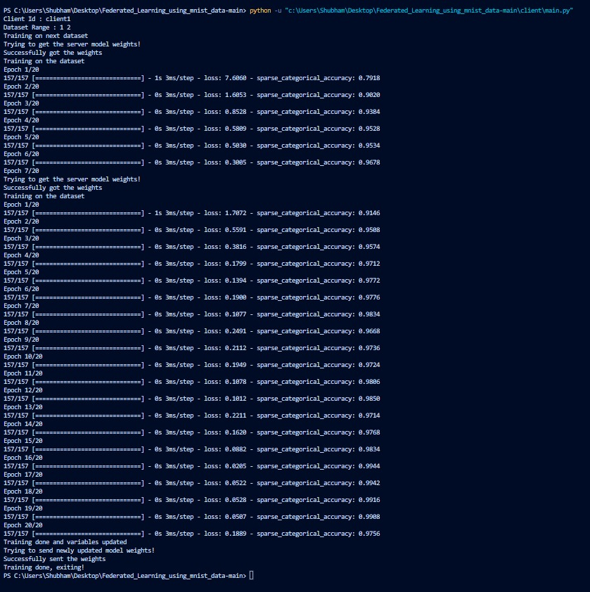
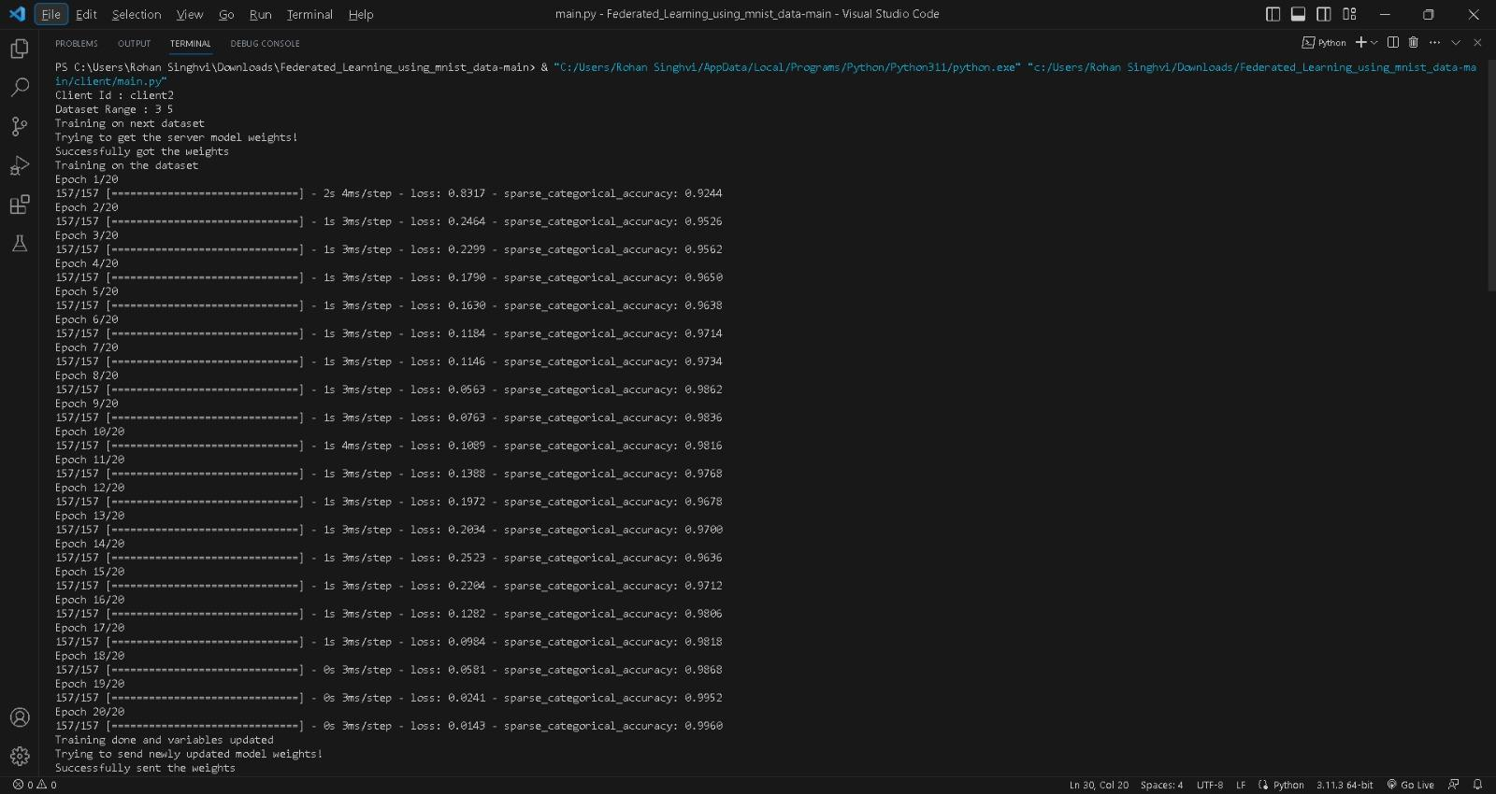
Clients:
Client 1
Client 2

Slide 15
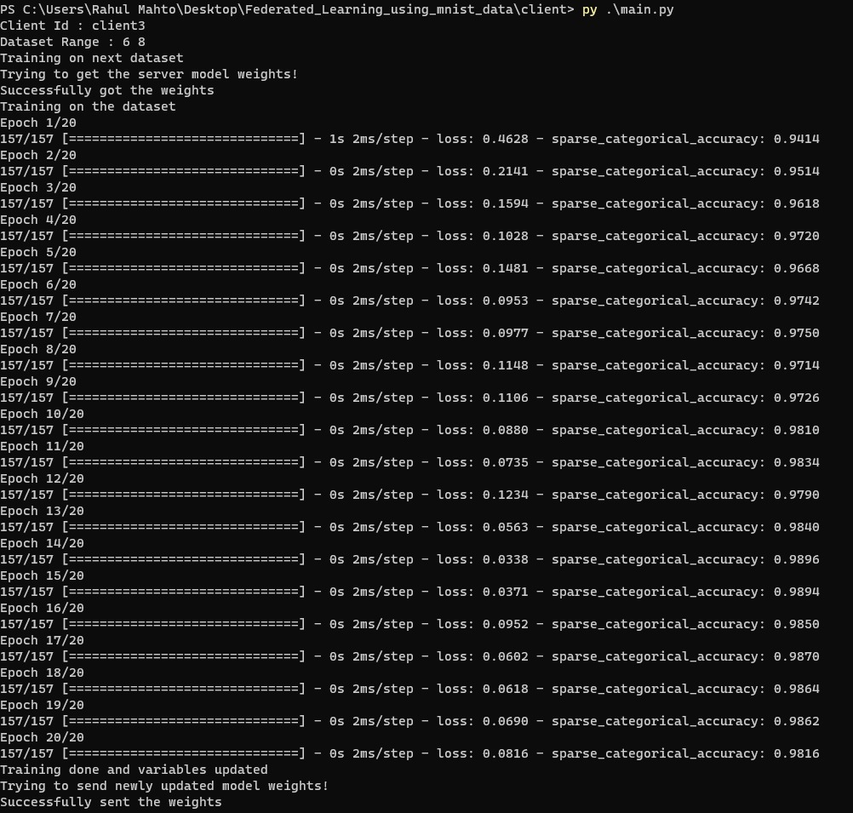
Client 3

Slide 16
Implementation
Server Implementation:The server keeps running. For each new request, it spawns a new thread to handle the request. It accepts only GET and POST requests.
Sending the updated model weights to the clients
Receiving the trained model weights from the clients
Server does a weighted average of the received model weights from the clients. Clients also send the number of datasets on which their model has been trained in total.
The server does the weighted average of their weights and the client weights and updates the weights at the server.
The server saves the model weights after every SAVE_MODEL (defined in server/server.py) updates in server/model file.

Slide 17
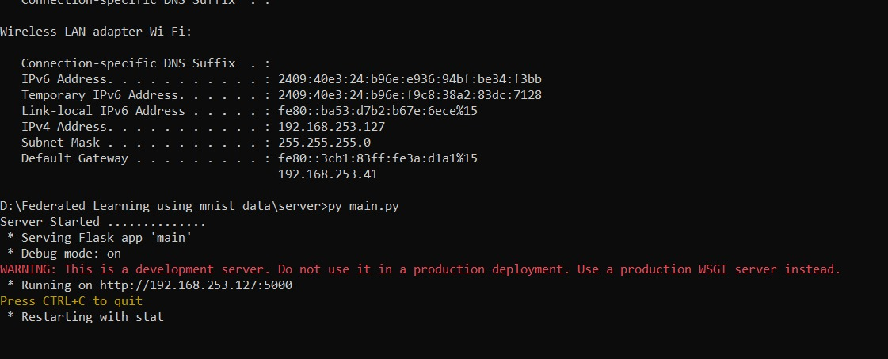
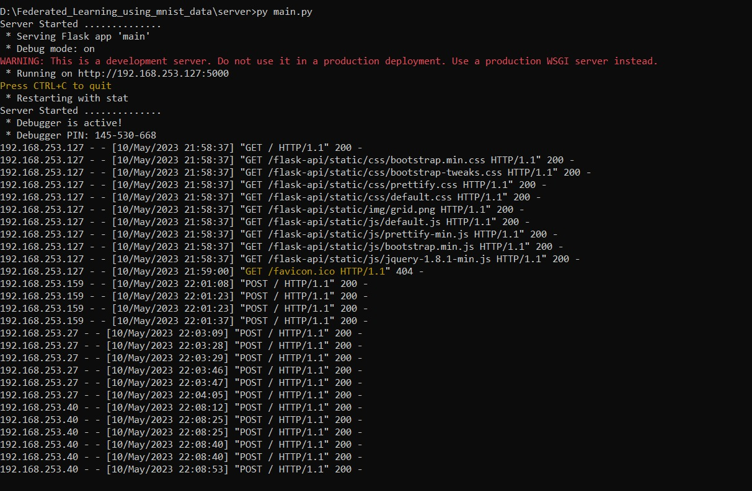
Screenshots
Server Side:

Slide 18
Implementation
Communication: Implement the communication mechanism between the clients and the server. This typically involves using HTTP requests or socket connections to send and receive data between the clients and the server.
Evaluation: Include evaluation mechanisms to measure the performance of the federated model on a separate test dataset. This can involve computing metrics such as accuracy, precision, recall, or any other relevant evaluation metric.

Slide 19
Working & Demo
Start the Server.
Check the IP Address using “ifconfig” command
Change the IP address in client file.
Start the client.
Test the Model

Slide 20
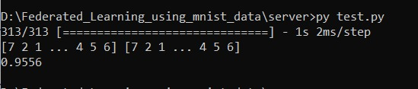
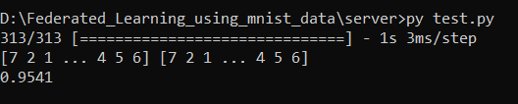
Testing Final Model

Slide 21
Challenges faced
Sending and receiving file in one go was an issue which was resolved by using WebSocket programming.
First we implemented the socket programing in a local device and we had to do it using many devices.
Training the model and sending the weights.

Slide 22
Conclusion
We have implemented a Federated Learning using Multiple system using ANN model and MNIST dataset. The clients are first connected to the server and then model is trained in each of the clients. The weights are then sent to the server where the main model is trained. Finally we test the dataset using the final model.

Slide 23
Future scope
Train the model on independent local clients.
Enhancing Privacy in Federated Learning
Optimizing Communication in Federated Learning
Scaling up Federated Learning

Slide 24
References
[1] Socket Programming https://idiotdeveloper.com/file-transfer-using-tcp-socket-in-python3/
[2] Communication-Efficient Learning of Deep Networks from Decentralized Data
https://arxiv.org/abs/1602.05629
[3] Monica Anderson. Technology device ownership: 2015. http://www.pewinternet.org/2015/10/29/
[4]Nitish Srivastava, Geoffrey Hinton, Alex Krizhevsky, Ilya Sutskever, and Ruslan Salakhutdinov. Dropout: A simple way to prevent neural networks from overfitting. 15, 2014.
[5]TensorFlow team. Tensorflow convolutional neural networks tutorial, 2016. http://www.tensorflow. org/tutorials/deep_cnn.

Slide 25
Thank You

